Slide 1
Exam 70-534 Architecting Microsoft Azure Solutions
#1 Design Azure Resource Manager (ARM) networking (5–10%)
Design Azure virtual networks - Extend on-premises
Describe Azure VPN and Express Route architecture and design
#2 Secure resources (20–25%)
Secure resources by using managed identities
Secure resources by using managed identities
Secure resources by using identity providers
Identify an appropriate data security solution
Design a role-based access control (RBAC) strategy
Manage security risks by using an appropriate security solution
#3 Design an application storage and data access strategy (5–10%)
Design data storage
Select the appropriate storage option
#4 Design advanced applications (20–25%)
Create compute-intensive applications
Create long-running applications
Integrate Azure services in a solution
Implement messaging applications
Implement applications for background processing
Design connectivity for hybrid applications
#5 Design Azure Web and Mobile Apps (5–10%)
Design Web Applications
Design Mobile Applications
#6 Design a management, monitoring, and business continuity strategy (20–25%)
Design a monitoring strategy
Describe Azure business continuity/disaster recovery (BC/DR) capabilities
Design a disaster recovery strategy
Design Azure Automation and PowerShell workflows
Describe the use cases for Azure Automation configuration
#7 Architect an Azure Compute infrastructure (10–15%)
Design ARM Virtual Machines (VMs)
Design ARM template deployment
Design for availability
+ Bonus: Containers
https://www.microsoft.com/learning/en-us/exam-70-534.aspx

Slide 2

Design a Management, Monitoring and Business Continuity Strategy
Monitoring Strategy
BC/DR Capabilities
Design DR Strategy
Azure Automation and PS WF
Automation Use Cases

Slide 3
#6 Design a management, monitoring, and business continuity strategy (20–25%)
1. Design a monitoring strategy
Identify the Microsoft products and services for monitoring Azure solutions
leverage the capabilities of Azure Operations Management Suite and Azure Application Insights for monitoring Azure solutions
leverage built-in Azure capabilities
identify third-party monitoring tools, including open source
describe Azure architecture constructs, such as availability sets and update domains, and how they impact a patching strategy
analyze logs by using the Azure Operations Management Suite
4. Design Azure Automation and PowerShell workflows
Create a PowerShell script specific to Azure, automate tasks by using the Azure Operations Management Suite
2. Describe Azure business continuity/disaster recovery (BC/DR) capabilities
Leverage the architectural capabilities of BC/DR
describe Hyper-V Replica and Azure Site Recovery (ASR)
describe use cases for Hyper-V Replica and ASR
3. Design a disaster recovery strategy
Design and deploy Azure Backup and other Microsoft backup solutions for Azure
leverage use cases when StorSimple and System Center Data Protection Manager would be appropriate
design and deploy Azure Site recovery
5. Describe the use cases for Azure Automation configuration
Evaluate when to use Azure Automation, Chef, Puppet, PowerShell, or Desired State Configuration (DSC)

Slide 4
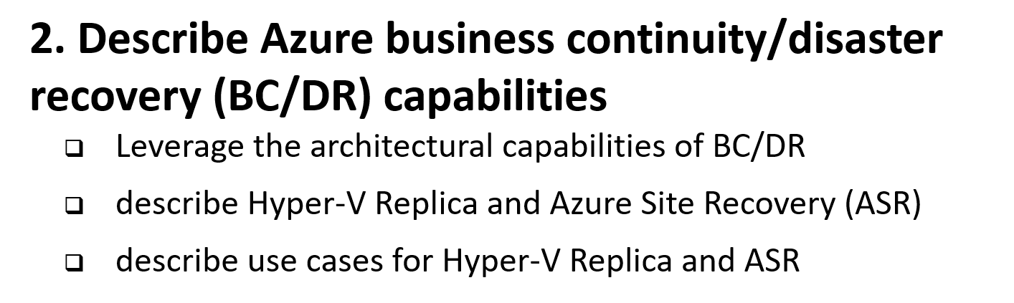
6 Manage, Monitory, Business Continuity

Slide 5
What is Business Continuity and Disaster Recovery (BC/DR)
Business Continuity (BC)
Disaster Recovery (DR)
Planning and preparation to ensure that the business can continue to operate (in a reasonable amount of time) after a disaster or serious business disruptive event.
Preventing or minimizing impact of a disaster or service disruptor event
Key Elements:
Resiliency – Keep running in case of failure
Recover – Recover or restore business functions that fail
Contingency - Plans in place in case an event happens. and is not covered by Resiliency or Recovery.
Business Continuity often deals with more than just technology. (eg. Plan for critical person/people that leave the company). This element not likely on the exam, but it does matter when you architect solutions in real life. If you have read “The Phoenix Project” it would be Brent!
Creating policies and processes to quickly restore services, data, and systems to full functionality
Recovering from a Disaster after it happens. It is often linked to Business Continuity as it is a subset of the Business Continuity plan.
Key Elements:
Availability, High Availability
Urgency to getting systems up and to what % of service.
Cost vs Time vs Risk
Hot/Worm/Cold site
Recovery as a Service (RaaS)
Disaster Recovery as a Service (DRaaS)
Cost to businesses for not doing BC/DR can be catastrophic

Slide 6
Azure BC/DR Capabilities & Use Cases
Hyper-V Replica
Simple, Affordable Second Site
“Extended Replication” + 3rd Party Integration
Hardware Agnostic – either side
Hybrid Cloud
Seamless Integration:
Private Cloud or on-premises to…
Service Provider Cloud
Microsoft Azure
Azure Site Recovery (ASR)
WHEN TO USE: 2nd Site / Use SCCM,SCVMM, Unprotected workloads
WHEN NOT TO USE:
Workload requires synchronous replication, data outside of VHD
Workload needs to recover physical servers, beyond Hyper-V replica’s capabilities

Slide 7
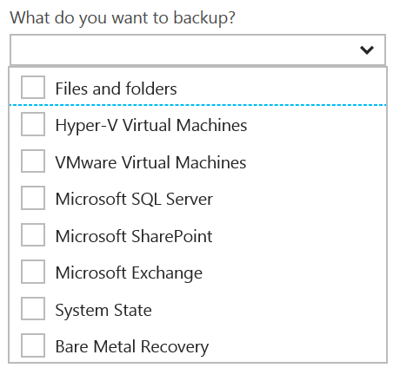
Disaster Recovery Capabilities & Use Cases
Azure Backup
Reliable, Simple, Efficient backup and restore (agent based)
Use for Branch Office or Small Business
Backup and restore files and folders
No Central Management
Azure Backup Server
Disk (D2D), giving high RTOs for tier 1 workloads
Azure (D2D2C) for long term retention
Modern Backup Storage technology (MABS v2)
VMware capabilities
Application Consistency (SQL, Exchange, SharePoint)
No Tape Backup
No Integration with System Center
Requires Azure Subscription
System Center Data Protection Manager (DPM)
Physical, VM, Azure VM
Store Locally to Disks (D2D) and to Tape (D2T)
Store in Azure (D2D2C) for long term retention
Full application consistency across server apps (Exch, SP, SQL…)
Small backup window
Bare Metal Recovery / Recovery to Azure
Full System Center Integration (discovery, reporting, etc)
StorSimple
Proprietary Device | Multiple Tiers
Cloud Integrated Storage (CiS)
Seamless view of ALL Enterprise Storage
Windows and VMWare
Multi-Tiers backup and recovery (Hot/Cold)
Fastest Solution
Long Term Azure storage; scale storage out to Azure
minimize on-premesis disk requirements
Seamless view of ALL Enterprise Storage | Windows and VMWare

Slide 8
Additional Information: SLA for Site Recovery 99.9%
"Failover" is the process of transferring control, either simulated or actual, of a Protected Instance from a primary site to a secondary site.
"On-Premises-to-Azure Failover" is the Failover of a Protected Instance from a non-Azure primary site to an Azure secondary site. Customer may designate a particular Azure datacenter as a secondary site, provided that if Failover to the designated datacenter is not possible, Microsoft may replicate to a different datacenter in the same region.
"On-Premises-to-On-Premises Failover" is the Failover of a Protected Instance from a non-Azure primary site to a non-Azure secondary site.
"Protected Instance" refers to a virtual or physical machine configured for replication by the Site Recovery Service from a primary site to a secondary site. Protected Instances are enumerated in the Protected Items tab in the Recovery Services section of the Management Portal.

Slide 9
RPO “Recover Point Objective” & RTO “Recover Time Objective are time intervals, typically expressed in number of hours
RPO is the maximum targeted time that data can be lost (in time)—it is the amount of time between backup, replication, or synchronization. It answers the question, “What is an acceptable amount of data loss?” It is usually much smaller than RTO.
RTO is how long it takes (in time) to restore services after a disaster. It answers the question, “How long will it take to get service back up?”

Slide 10
An asynchronous operation is one that transpires sequentially: first one action, and then another. The operations do not take place simultaneously. This type of processing means that there is a time gap between the first operation and the second. An example would be writing data to primary and secondary storage. First data is written to the primary; data destined for the secondary is queued and must wait until the write operation to the primary is complete.

Slide 11
Synchronous means that operations are carried out at the same time (think of this as parallel processing). With this type of processing, there is no time gap between the first process and the second process. Both operations take place simultaneously.

Slide 12
Sharding is when you split a database and partition the different parts of the database across multiple drives. A shard is a single horizontal partition of the database.

Slide 13
AzureRM.RecoveryServices.Backup (PowerShell)
Backup Azure VMs using Automation
Concepts
Setup and Registration
Create a recovery services vault
View the vaults in a subscription
Back up Azure VMs
Trigger a backup
Monitoring a backup job
Restore an Azure VM
Create a VM from restored disks
Next steps
https://docs.microsoft.com/en-us/azure/backup/backup-azure-vms-automation

Slide 14
Data Protection Manager & Azure Backup
DPM will backup more workloads
SQL, Exchange, SharePoint
DPM is deployed on-premises as a physical server or virtual machine—If you deploy DPM as a physical server or as an on-premises Hyper-V virtual machine you can back up data with Azure Backup in addition to backing data up to disk and tape.
Azure Backup provides a simple method of offsite storage. You can store data with Azure up to 3360 days
DPM is deployed as a virtual machine in Azure—If DPM is deployed as an Azure virtual machine (possible from System Center 2012 R2 with Update 3 or later) you can back up data to Azure disks attached to the DPM Azure virtual machine and then offload data storage with backup to Azure Backup.
You can offload storage to Azure Backup from the Azure disk, allowing you to scale up by storing older data in Azure Backup and new data on disk
https://technet.microsoft.com/en-us/library/jj728752(v=sc.12).aspx

Slide 15
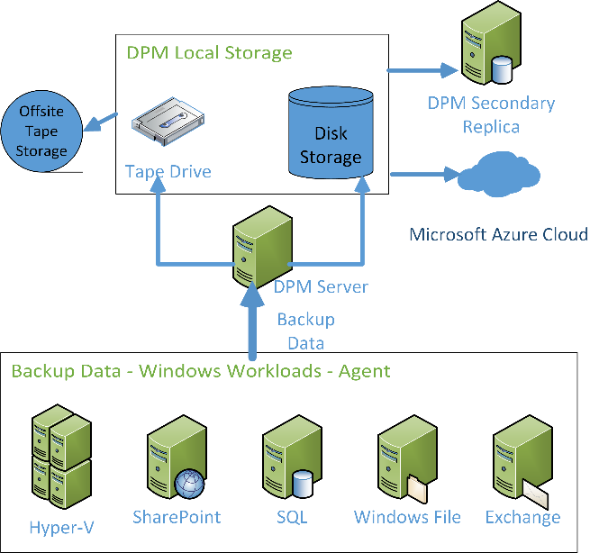
DPM Architecture
Data Protection Manager backing up Microsoft workloads and sending that data through the Data Protection Manager server to local storage and tape, the tape is being sent offsite. Data is also being sent to a Data Protection Manager Secondary Replica and to Microsoft Azure.

Slide 16
READ & Practice https://docs.microsoft.com/pdfstore/en-us/Azure.azure-documents/live/backup.pdf
Link from https://docs.microsoft.com/en-us/azure/backup/backup-try-azure-backup-in-10-mins – Download PDF

Slide 17
EXAM TIP!
In the Azure PowerShell command, OB stands for Online Backup. If you get an Azure PowerShell exam question on backup, make sure that your answer is using the Online Backup or OB version of the command; for example:
Get-OBPolicy retrieves the current backup policy, which includes the schedule.
Start-OBBackup –Policy $policy –Force executes a Backup Now.
To run Azure PowerShell modules for Online Backup, you must be running with Administrative permissions (elevated).

Slide 18
Azure Backup Key Workloads
Specialized Workloads
File/Folders/Volumes
Virtual Machines
Exchange
SharePoint
SQL Server
Windows Server
Windows
Windows
Linux
Hyper-V
Windows Server
Microsoft Azure
VMware
Notes:
1.
Workload: Files and folders
Source Machine: Windows Server or Windows Client
Azure Backup Solutions:
Azure Backup agent,
System Center DPM (+ the Azure Backup agent),
Azure Backup Server (includes the Azure Backup agent)
2.
Workload: Hyper-V virtual machine (Win & Linux), VMWare Virtual Machine (Win & Linux), Microsoft SQL Server, Microsoft SharePoint, Microsoft Exchange
Source Machine: Windows Server
Azure Backup Solution: System Center DPM (+ the Azure Backup agent); Azure Backup Server (includes the Azure Backup agent)
3.
Workload: Azure IaaS VMs (Windows) and Azure IaaS VMs (Linux)
Source Machine: N/A
Azure Backup Solution: Azure Backup (VM extension)

Slide 19
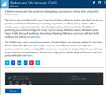
How It Works: Azure Backup Server
2. Register and configure Vault
1. Create Backup and Site Recovery Vault
3. Install Azure Backup Server software
4. Schedule & Back up encrypted data
Azure Backup Windows Server/Client
5. Recover to the same or a different server; On-Premisis or Azure VM
Step-By-Step
https://docs.microsoft.com/en-us/azure/backup/backup-try-azure-backup-in-10-mins
Notes:
Sign Up at the Azure portal
Install Azure Backup Server software
Register and configure
Back up encrypted data
Anytime the data leaves your boundary, it is encrypted. You have the passwords and keys and it’s always restored in Azure.
Recover to the same or a different server

Slide 20
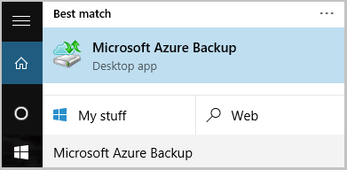
Name of the Backup agent Installer is:
MARSagentinstaller.exe
Backup Agent is
Microsoft Azure Backup
"C:\Program Files\Microsoft Azure Recovery Services Agent\bin\wabadmin.msc"
Maximum rate of backups per day?
Three (3) times per day!

Slide 21
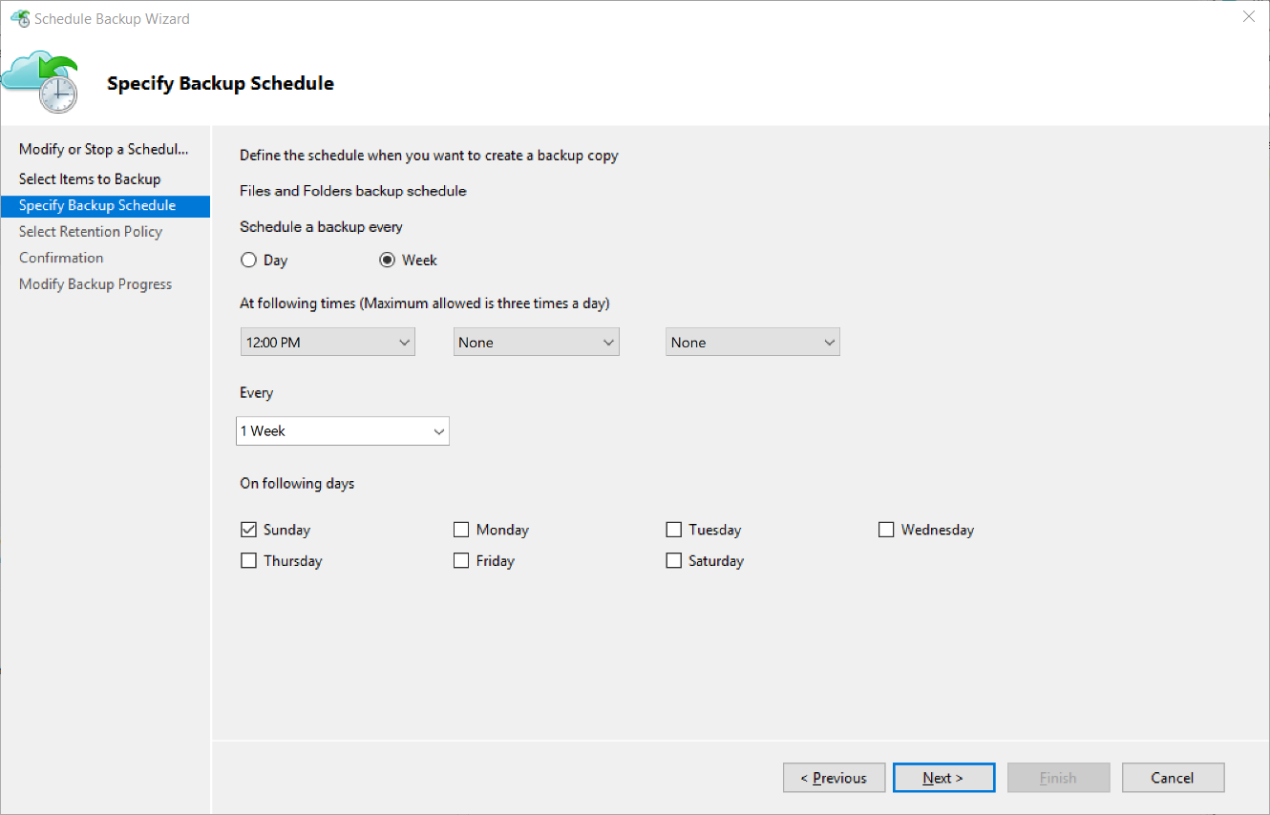
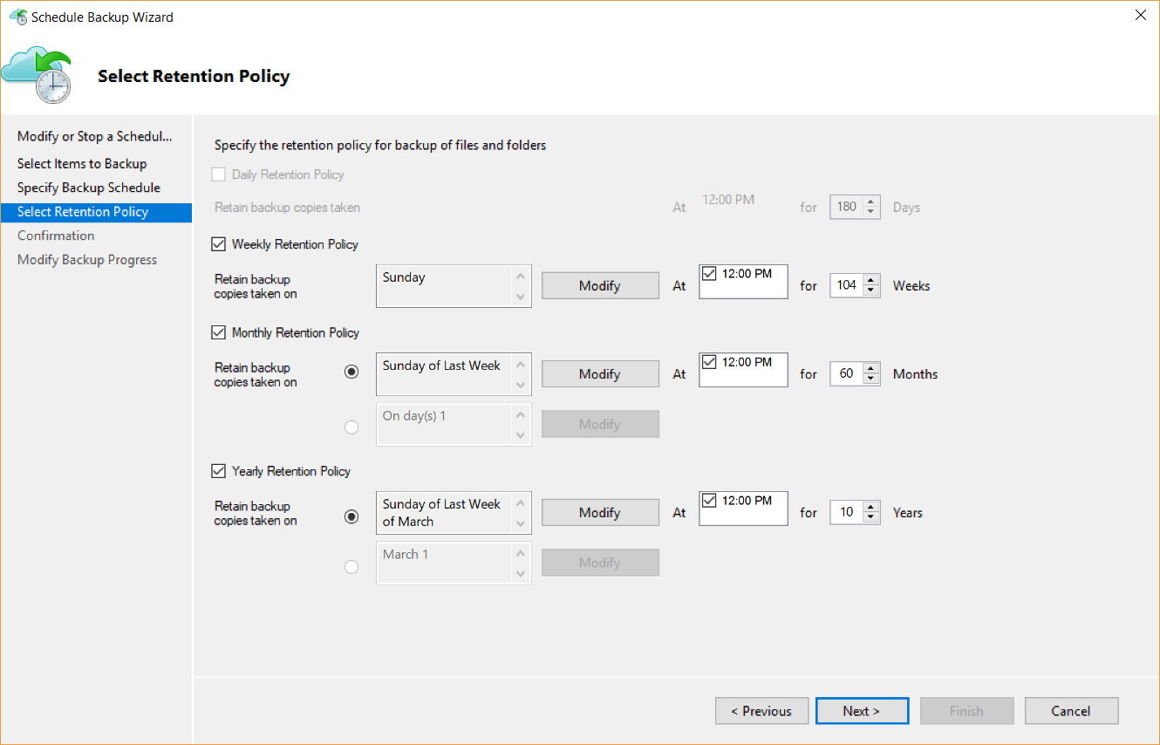
Backup Schedule & Retention Policy
Backup Schedule
Retention Policy

Slide 22
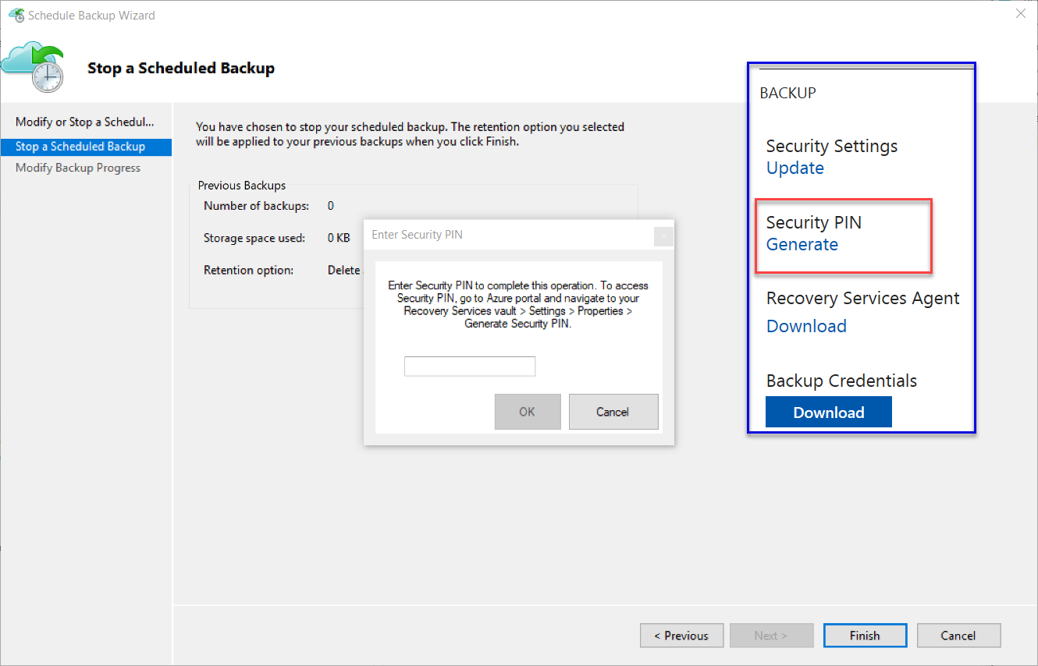
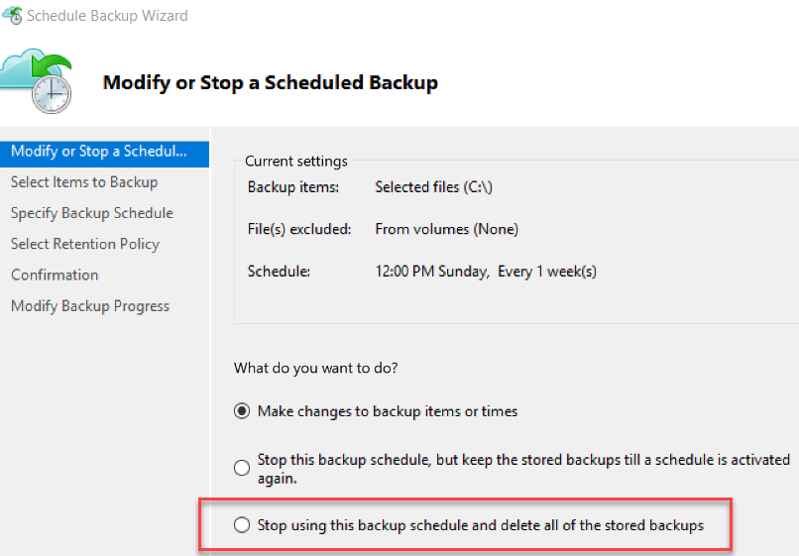
Cancelling Schedule and Removing Backups

Slide 23
Microsoft Azure Backup Server v2
Protect application workloads:
Hyper-V VMs, Microsoft SQL Server, SharePoint Server, Microsoft Exchange and Windows clients
Backup To:
Disk (D2D), giving high RTOs for tier 1 workloads
Azure (D2D2C) for long term retention
Modern Backup Storage technology (MABS v2) store backups:
Using Resilient File System (ReFS) block-cloning technology to store incremental backups,
MABS v2 significantly improves storage usage and performance.
Note: VMware is supported only in testing if Azure Backup Server is deployed on Windows 2016
Microsoft Azure Backup Server (MABS) Deployment:
physical standalone server.
Hyper-V virtual machine
Windows virtual machine in VMWare
Physical standalone server
Hyper-V virtual machine
Windows virtual machine in VMWare
An Azure virtual machine - back up cloud workloads running as Azure virtual machines.
Disks for backup storage pool: 1.5 times size of data to be protected
Docs: https://azure.microsoft.com/en-us/blog/announcing-microsoft-azure-backup-server/
Download: https://www.microsoft.com/en-us/download/details.aspx?id=55269

Slide 24
Documentation / More Info…
Azure Key Vault:
https://docs.microsoft.com/en-us/azure/key-vault/
Azure Backup:
https://docs.microsoft.com/en-us/azure/backup/

Slide 25
When you create a recovery vault for Backup, use a different region than that of the servers and services you will be backing up. This will provide a level of protection against a regional disaster such as the failure of an Azure datacenter or hurricane that can take out an entire region including your on-premises datacenter.
Backup imposes a limit of 1,700 GB of data per volume that that you can back up in one backup operation
Limit of 366 Restore Points
Almost 10 years of retention (3,360 days / 9.2 years)

Slide 26
More Tools + 3rd Party Tools --- Many
Most Backup Solutions will now backup to Azure; Including:
3rd Party
Microsoft
Veeam Backup – Restore Directly to Azure; Many workloads including SharePoint, AD, Exchange, Files, SQL…
NetBackup
Veritas
Acronis
CommVault
More…
Microsoft® SQL Server® Backup to Microsoft Azure®Tool https://www.microsoft.com/en-us/download/details.aspx?id=40740
AZCopy https://docs.microsoft.com/en-us/azure/storage/storage-use-azcopy

Slide 27
Lab: Azure Backup in 10 Mins
Create a recovery services vault
Configure the vault
Install and register the agent
Back up your files and folders
Questions?
Next steps
https://docs.microsoft.com/en-us/azure/backup/backup-try-azure-backup-in-10-mins

Slide 28
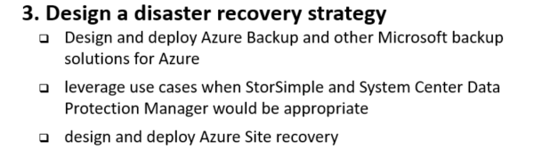
6 Manage, Monitory, Business Continuity

Slide 29


StorSimple architecture: A new approach
StorSimple Cloud Appliance
Azure
Applications
Microsoft Azure
Periodic VSS consistent cloud snapshots of production data
Internet
Internet
Customer datacenter
Remote/branch offices
Hyper-V
Hyper-V
SAN
Linux
Linux
SAN
NAS
StorSimple Physical Array
VMware
StorSimple Virtual Array
VMware
Notes:
This slide puts it all the solution components together : StorSimple is an easy way to connect any server on any Hypervisor environment – including Hyper-V, Linux, or VMware - to the cloud….with no app modification.
Further, as you can see, we now have the flexibility of configuring StorSimple as a SAN or a NAS device in the customer environment (replacing traditional SAN & NAS devices). i.e. To a customer, it looks like a SAN or a NAS device – with the added advantage of being able to connect to the cloud. And cloud is what brings all the unique differentiators to the StorSimple solution : including …auto tiering, cloud based data protection, and DR. This is huge – because now customers are able to combine several heterogeneous pieces of traditional storage solutions (like tape, archival, back-up & restore) into one elegant solution – with a single management console. StorSimple Manager provides a single view & management capabilities for both physical and virtual arrays, as well as StorSimple Cloud Appliance. In addition, StorSimple can be further enhanced for scenarios like enterprise collaboration with our partners like Talon, and video surveillance with MileStone.

Slide 30
How StorSimple works
Enables data mobility between your datacenter and the cloud
StorSimple tiers data
moving aging, less accessed data to the cloud, at lower costs
rather than keeping it with your mission-critical data in your datacenter (or at some remote location).
However, the data in the cloud is still safe and reliably accessible.
This results in:
Lower total storage costs by up to 60%
Improve data protection
Increase storage agility
Enable virtually bottomless storage
Notes:
This slide puts it all the solution components together : StorSimple is an easy way to connect any server on any Hypervisor environment – including Hyper-V, Linux, or VMware - to the cloud….with no app modification.
Further, as you can see, we now have the flexibility of configuring StorSimple as a SAN or a NAS device in the customer environment (replacing traditional SAN & NAS devices). i.e. To a customer, it looks like a SAN or a NAS device – with the added advantage of being able to connect to the cloud. And cloud is what brings all the unique differentiators to the StorSimple solution : including …auto tiering, cloud based data protection, and DR. This is huge – because now customers are able to combine several heterogeneous pieces of traditional storage solutions (like tape, archival, back-up & restore) into one elegant solution – with a single management console. StorSimple Manager provides a single view & management capabilities for both physical and virtual arrays, as well as StorSimple Cloud Appliance. In addition, StorSimple can be further enhanced for scenarios like enterprise collaboration with our partners like Talon, and video surveillance with MileStone.

Slide 31
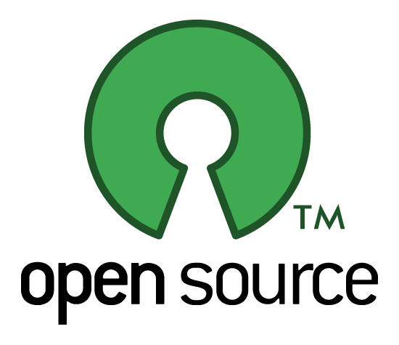
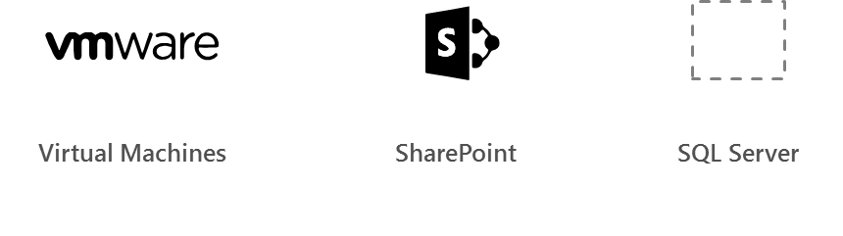
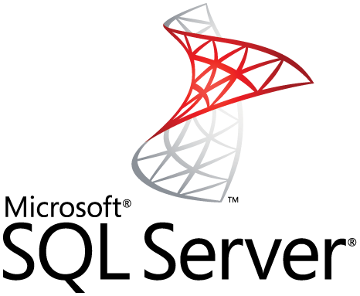

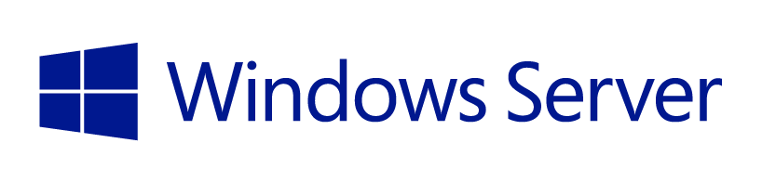
Supported workloads
How customers benefit
Infrastructure on-demand workloads
DR
Search / Data mining
Dev / Test
Cloud apps
Capacity driven workloads
Traditional on-premises workloads
File shares
Collaboration
Archives
VM workloads
SharePoint
SQL Server
Notes:
This slide is shows the alignment of different workloads with different capabilities / configurations of StorSimple solution.
For large, unstructured, capacity driven data-sets, use tiered volumes for cloud storage
For performance driven workloads – use local volumes as a local storage.
For on-demand infra requirements like DR, and dev-test, use the StorSimple Cloud Appliance
So what does all these enhancements mean for partners?

Slide 32
Integrated data protection and DR
How customers benefit
Largescale, on-demand capacity for data protection
Location independence for disaster recovery
Shortened RTO for data availability for apps
No purchases, upgrades and maintenance for backups and tapes
Capability to test and validate DR
DR automation and single-click orchestration
StorSimple Cloud Appliance
Azure
Applications
Microsoft Azure
Periodic VSS consistent cloud snapshots of production data
Data Center 1
Data Center 2
DR
Production data
Production data

Slide 33
Test, validate, and accelerate DR
How customers benefit
Cloud Backup (target for backup software) With 100 Mbps WAN Link
StorSimple ‘instant recovery’
= faster RTO than tapes
and cloud gateway backups
90 Days
30 Days
Tape
7 Days
RTO is independent of volume sizes
>100x faster than tapes and regular cloud backup
Off-site Backups
1 Day
StorSimple Cloud Snapshots with 50 Mbps WAN link
1 Hour
15 Min.
1 TB
5 TB
20 TB
50 TB
100 TB
Primary Data

Slide 34
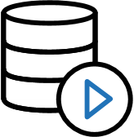
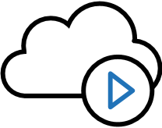
Focus on business outcomes
How customers benefit
On-demand storage
On-demand services in Azure
Consolidated management
Highly scalable, cost-effective and secure data storage. No need for incessant planning, upgrade and maintenance
Cloud provides IaaS to deploy applications that use StorSimple data in the cloud. No long lead times for new business projects
No need to manage separate data protection solutions or be on-site. Up-to-the-minute status and consistent control in all sites

Slide 35



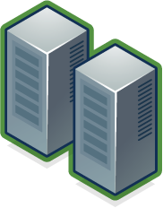
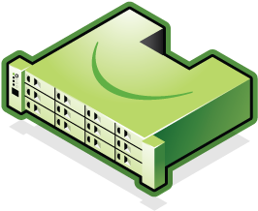
Cloud Snapshots Provide Rapid Recovery
Cloud
Snapshots
Production Data
Production Data
Enterprise Data Center 1
Enterprise Data Center 2
Connect many servers to cloud storage and scale data sets with StorSimple solution
Rapidly recover to any data center (location independent) via mounting the cloud
Notes:
Slide Objective: Discuss rapid recovery capabilities provided by StorSimple in the event of a datacenter outage.

Slide 36
EXAM TIP!
StorSimple uses iSCSI protocol to link data storage. This means that the storage that is in Azure is presented as locally attached iSCSI volumes.

Slide 37
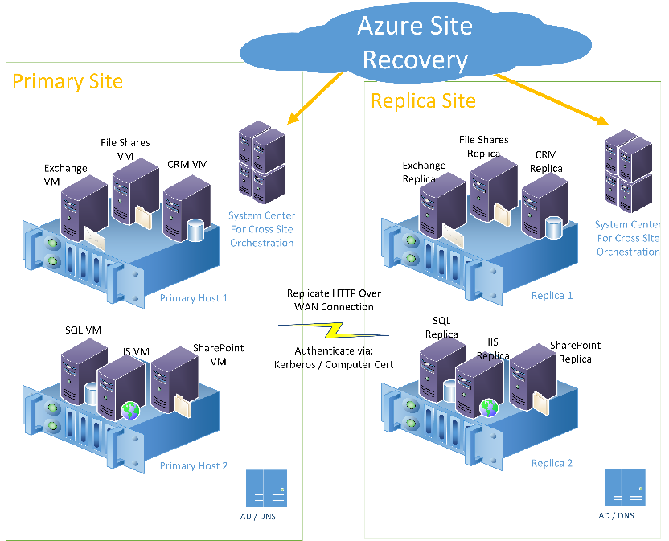
6.3.3 Site Recovery primary site and replica site
Azure Site Recovery monitoring a primary and replica site. The sites have workloads such as Exchange, CRM, IIS, SQL, and SharePoint running on hosts. Azure Site Recovery communication goes through System Center. System Center actually performs the orchestration of the cutover

Slide 38
Replicate Hyper-V virtual machines (without VMM) to Azure using Azure Site Recovery with the Azure portal
https://docs.microsoft.com/en-us/azure/site-recovery/site-recovery-hyper-v-site-to-azure

Slide 39
Replicate physical machines to Azure by using Site Recovery
https://docs.microsoft.com/en-us/azure/site-recovery/site-recovery-physical-servers-to-azure

Slide 40
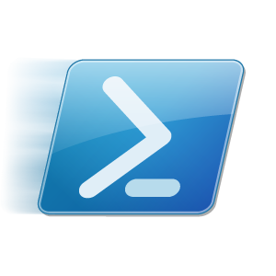
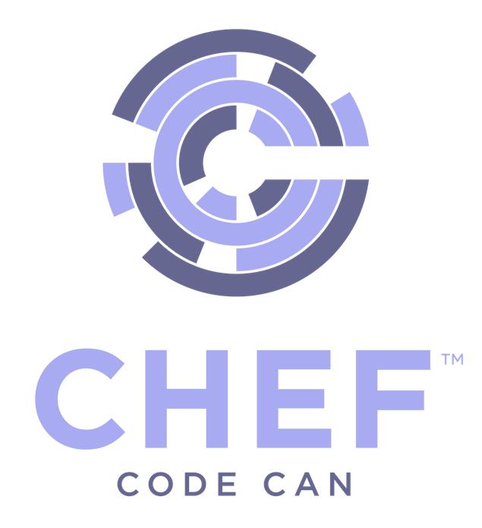
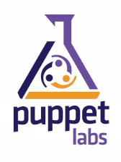
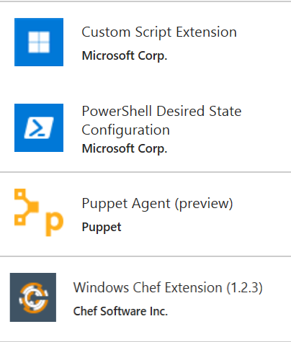
Azure Automation
Azure Automation
Runbooks
Chef Configure and Automate. Apply Fine Grained Permissions
https://www.chef.io/solutions/windows/
Puppet Can Configure and Manage Windows and Azure
http://puppetlabs.com/solutions/microsoft
Desired State Configuration
Make it So https://docs.microsoft.com/en-us/azure/automation/automation-dsc-overview
In the portal + New – Azure Automation
DevOps Enabler
Others, Docker, Ansible, SaltStack, etc.

Slide 41
Which to use? All can be used with Windows & Linux
Chef
If you already have a Chef management infrastructure
If your primary expertise is managing Linux machines
Puppet
If you already have a Puppet management infrastructure
If your primary expertise is managing Linux machines
DSC
If you do not already have a Configuration Management Solution
If your primary experience is in managing Windows machines
Uses vender-neutral configuration files (MOF)
If you already have PowerShell expertise
Azure Automation
If you do not already have a Configuration Management Solution, or not deeply embedded
If you want to significantly expand your configuration management without significant expense
If you already own OMS
If you already have PowerShell expertise

Slide 42
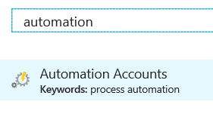
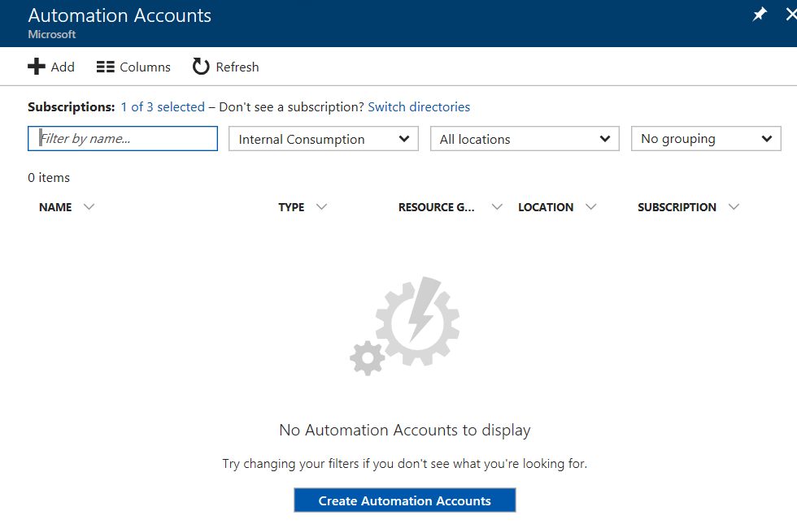
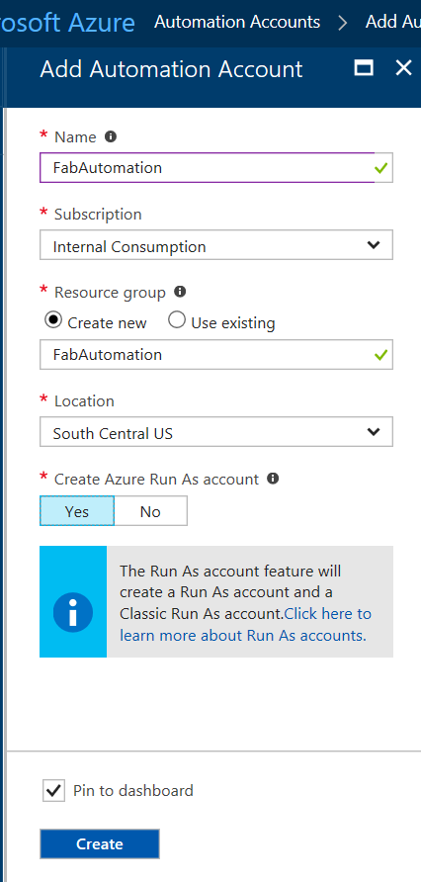
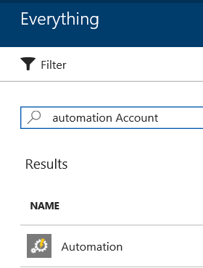
Demo
Add
Azure
Automation
Account
https://docs.microsoft.com/en-us/azure/automation/automation-create-standalone-account

Slide 43
Create a standalone Azure Automation account
Create a new Automation Account from the Azure portal
https://docs.microsoft.com/en-us/azure/automation/automation-create-standalone-account

Slide 44
Why Azure Automation
Simplify cloud management with process automation
Save time and money with automation
Eliminate time-consuming, repetitive tasks
Eliminate human mistakes
Improve reliability, efficiency and speed
Use with Azure and partner cloud services
Integrate with any service using PowerShell scripts
Get a highly-available automation engine
Lower Operating Costs
Enable DevOps

Slide 45
Azure Automation Use Cases
Monitoring Configurations
Eliminate Configuration Drift
Automated Change of Configuration
Maintain Exact Configuration (override other changes)
Automated Testing
Automating Usage – Auto Start – Auto Stop
Automating Hybrid Scenarios
Automated Deployment
Implement DevOps practices

Slide 46
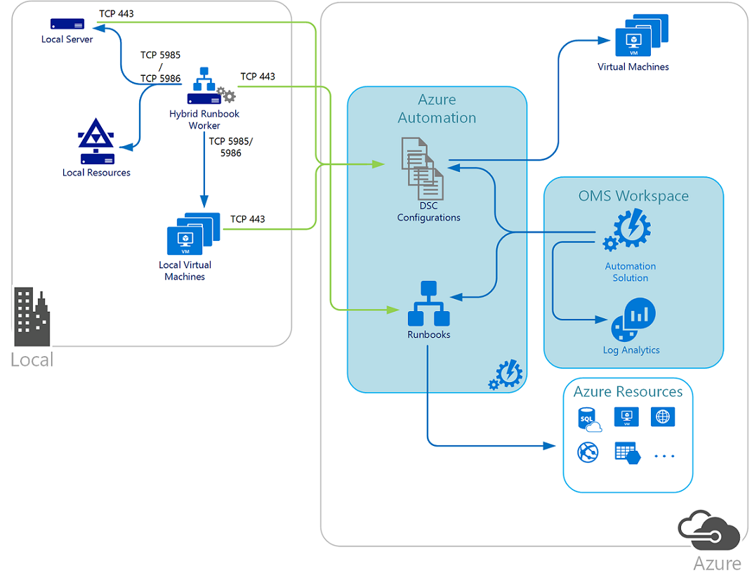
Hybrid Azure Automation - DSC
DSC configurations stored in Azure Automation can be directly applied to Azure virtual machines. Other physical and virtual machines can request configurations from the Azure Automation DSC pull server.
Note
TCP 443 from local to Azure
TCP 5985/5986 Hybrid Runbook Worker to local machines and resources
Hybrid Runbook worker is running locally and managing local resources
https://docs.microsoft.com/en-us/azure/automation/automation-offering-get-started

Slide 47
Azure Automation Runbooks
Introduction: https://docs.microsoft.com/en-us/azure/automation/automation-intro
Based on Windows PowerShell or Windows PowerShell Workflow, so they do anything PowerShell can do
Can work with application or service API’s
Use PowerShell Modules
Can access any cloud resources
Hybrid Runbook Worker an run in your local datacenter and manage local resources. https://docs.microsoft.com/en-us/azure/automation/automation-hybrid-runbook-worker
Learning PowerShell Workflow Concepts for Automation runbooks https://docs.microsoft.com/en-us/azure/automation/automation-powershell-workflow

Slide 48
PowerShell Runbooks vs Workflows
PowerShell runbooks have the same lifecycle, capabilities, and management as PowerShell Workflow runbooks but there are some differences and limitations:+
PowerShell runbooks run fast compared to PowerShell Workflow runbooks as they don’t have compilation step.
PowerShell Workflow runbooks support checkpoints, using checkpoints, PowerShell Workflow runbooks can resume from any point in the runbook whereas PowerShell runbooks can only resume from the beginning.
PowerShell Workflow runbooks support parallel and serial execution whereas PowerShell runbooks can only execute commands serially.
In a PowerShell Workflow runbook, an activity, a command, or a script block can have its own runspace whereas in a PowerShell runbook, everything in a script runs in a single runspace.
Some syntactic differences between a native PowerShell runbook and a PowerShell Workflow runbook. https://technet.microsoft.com/en-us/library/dn151046.aspx

Slide 49
Lab
My first graphical runbook
https://docs.microsoft.com/en-us/azure/automation/automation-first-runbook-graphical
My first PowerShell runbook
https://docs.microsoft.com/en-us/azure/automation/automation-first-runbook-textual-powershell
My first PowerShell Workflow runbook
https://docs.microsoft.com/en-us/azure/automation/automation-first-runbook-textual

Slide 50
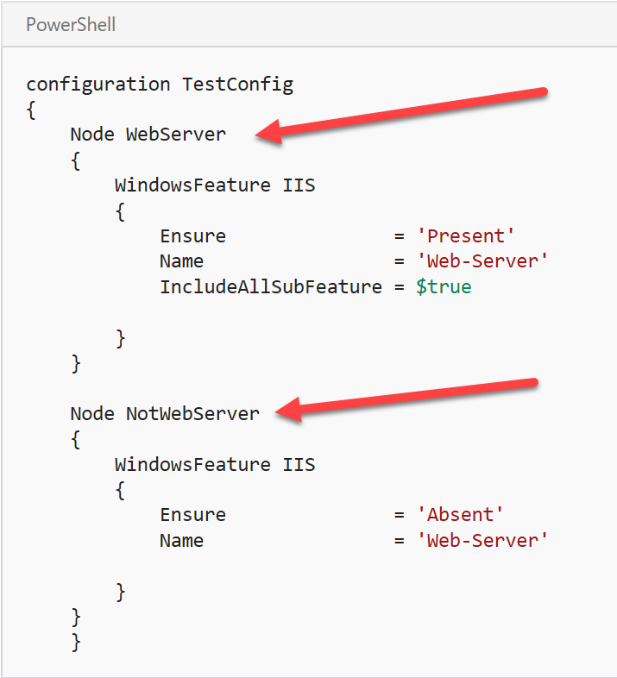
Lab Getting Started with Azure Automation DSC Desired State Configuration (DSC) {Make it So}
Prerequisites
Creating a DSC configuration
Importing a configuration into Azure Automation
Viewing a configuration in Azure Automation
Compiling a configuration in Azure Automation
Viewing a compilation job
Viewing node configurations
Onboarding an Azure VM for management with Azure Automation DSC
Viewing the list of DSC nodes
Viewing reports for DSC nodes
Reassigning a node to a different node configuration
Unregistering a node
Related Articles
DSC Overview:
https://docs.microsoft.com/en-us/azure/automation/automation-dsc-overview
Lab: https://docs.microsoft.com/en-us/azure/automation/automation-dsc-getting-started

Slide 51

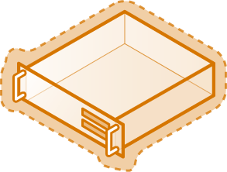
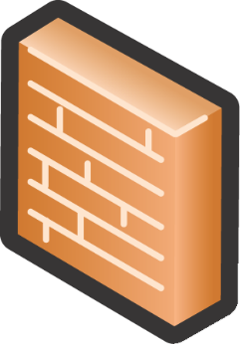
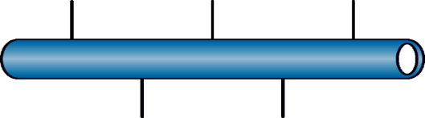
Azure Infrastructure Services
Load-Balanced Set
Cloud Service
Endpoint
VM & Data Disks
Private port
Public port
Availability Set
AutoScaling
DIP
Incoming Requests
DIP
…
Regional Vnet
VIP
Load
Balancer
DIP
DNS
DIP
Site-to-Site gateway
Point-to-Site
gateway
VIP - Public IP assigned by Azure and bound to a cloud service
DIP – Internal IP assigned by Azure to the vNIC of a VM via DHCP
Endpoint – a pair of a public port and a private port for communicating with a cloud service
Notes:
© 2014 Yung Chou.

Slide 52
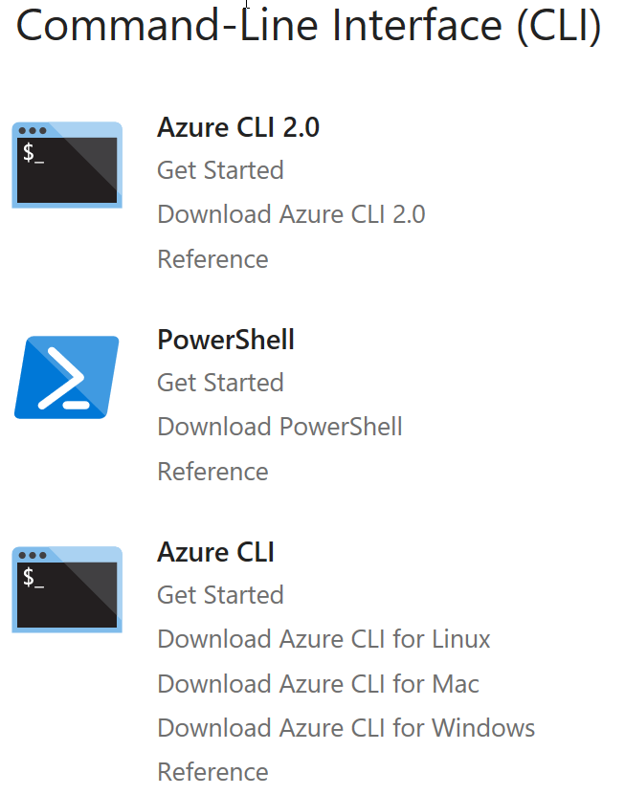
PowerShell
Getting Started with Azure
Need help with PowerShell? If you are unfamiliar with PowerShell, see Scripting with PowerShell. https://technet.microsoft.com/en-us/library/bb978526.aspx
Review the Install article to get Azure PowerShell running https://docs.microsoft.com/en-us/powershell/azure/install-azurerm-ps. Using PowerShellGet requires an Execution Policy that allows you to run scripts. For more information about PowerShell's Execution Policy, see About Execution Policies.
Get-Module PowerShellGet -list | Select-Object Name,Version,Path # If you do not have PowerShellGet installed, you will need to install the latest version of WMF
Install the Azure Resource Manager modules from the PowerShell Gallery
Install-Module AzureRM –AllowClobber # Reply Y to trust the PSGallery (Requires Elevation)
Import-Module AzureRM # Does not require elevation
List other available AzureRM modules
Get-Module -ListAvailable AzureRM
Login to Azure
Login-AzureRmAccount
Get-AzureAccount # List my Azure Accounts
Get-AzureSubscription
Set the Default Subscription
Set-AzureRmContext -SubscriptionID <subscriptionId>
https://docs.microsoft.com/en-us/azure/#pivot=sdkstools

Slide 53
PowerShell Working with a VM using RM --- NEED TO UPDATE TO RM
Get-AzureVM List Azure VM’s.
Create a new VM:
New-AzureVMConfig Creates a new VM configuration object. You can then use this object to perform a new deployment as well as to add a new VM to an existing deployment.
Add-AzureProvisioningConfig Adds the provisioning configuration to an Azure VM.
Set-AzureSubnet Sets the subnet list for a VM configuration.
New-AzureVM Adds a new VM to an existing Azure service, or creates a new VM and service in the current subscription if either the -Location or -AffinityGroup is specified.
Example:
New-AzureVMConfig -Name <VmName> -InstanceSize Small –ImageName <ImageNameVHDString> ` | Add-AzureProvisioningConfig –Windows –Password <adminPassword> -AdminUsername <adminusername> ` | Set-AzureSubnet 'AD-Production' ` | New-AzureVM –ServiceName <MyServiceName> -VNetName <MyNetworkName>
Remove-AzureVM Removes an Azure VM (Note this command provides a -DeleteVHD switch to also remove the underlying disks when you remove the AzureVM) .
Restart-AzureVM Restarts an Azure VM.
Start-AzureVM Requests the start of an Azure VM.
Stop-AzureVM Requests a shutdown of a VM (includes deallocate d status unless -StayProvisioned parameter is passed).
Update-AzureVM Accepts update information for the specified VM and initiates the update. You can add or remove data drives, modify the cache mode of data or operating system disks, change the network endpoints, or change the size of the VM.
You can use “VM Name” or VM.Object in all scripts; for example
Restart-AzureVM [-Name] <String> [-ServiceName] <String> [<CommonParameters>]
or:
Restart-AzureVM -VM <PersistentVM> [-ServiceName] <String> [<CommonParameters>]
Add-AzureVhd Uploads a VHD to Azure (as a fixed drive) and converts from dynamic to fixed.
Get-AzureDisk [[-DriveName] <String>] [<CommonParameters>] Get a particular drive with which to work.
Add-AzureDisk Adds a new drive to the Microsoft Azure drive repository in the current subscription. This drive is bootable if you specify the optional -OS parameter. If you don’t specify it, the drive is a data drive. The required parameters are DiskName and MediaLocation.
Add-AzureDataDisk Adds a new data drive to a VM object. Use the -CreateNew parameter to create a new data drive with a specified size and label, and then attach it. Use the -Import parameter to attach an existing drive from the image repository. Use the -ImportFrom parameter to attach an existing drive from a Blob in a storage account. Using this cmdlet, you can specify the host-cache mode of attached data drives.
Author: What is this? To what is it referring? This is kind of coming from out of the blue, so I think we need some more description here.
done
Author: Is this part of the command? Should it be in italic?
No, there is not a deallocation command. Deallocation is a status.

Slide 54
PowerShell Working with a VM using ARM

Slide 55
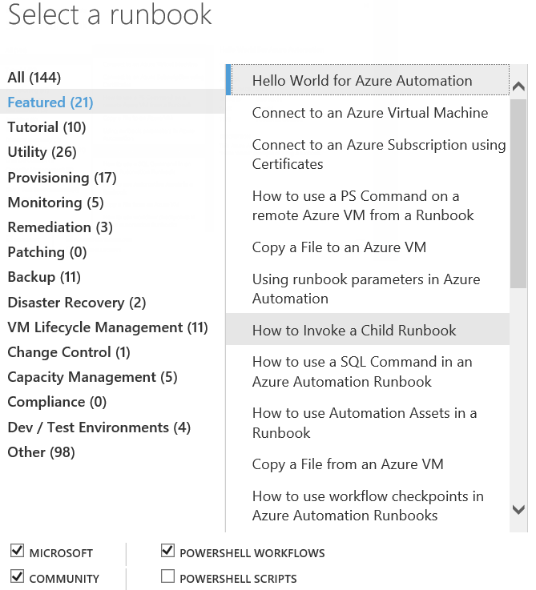
PowerShell Runbooks

Slide 56
6.1 Summary
System Center is made up of many components that can help you to manage, monitor, orchestrate, and protect systems.
Designing solutions for a hybrid scenario can save time and money while simplifying and automating IT tasks
The larger an enterprise, the more likely it needs automation, management, monitoring, and protection. However, the tools and use cases for hybrid scenarios are relevant for any size of business .
“size of business”? “business size”?
No clue?

